Slide 1
Discrete Random Variable, Expectation an

Slide 2
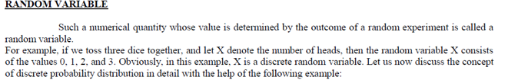
As stated in the very beginning of this course, there are two types of quantitative variables --- the discrete variable, and the continuous variable. Accordingly, we have the discrete probability distribution as well as the continuous probability distribution.
We begin with the discussion of the discrete probability distribution.
In this regard, the first concept that we need to consider is the concept of Random variable.

Slide 3
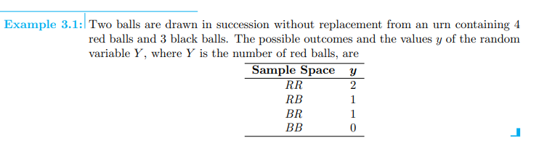



Slide 4
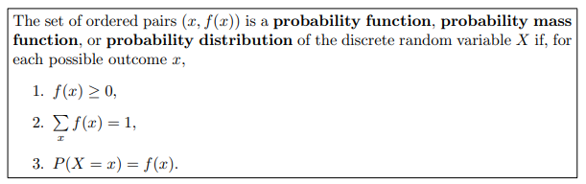

Slide 5
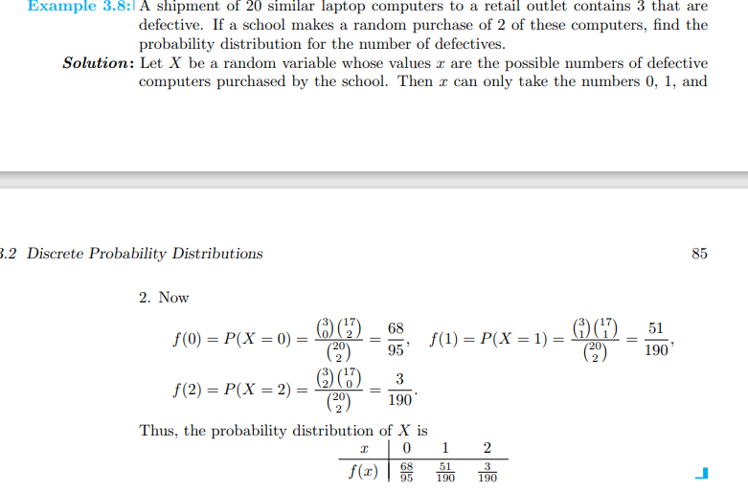

Slide 6
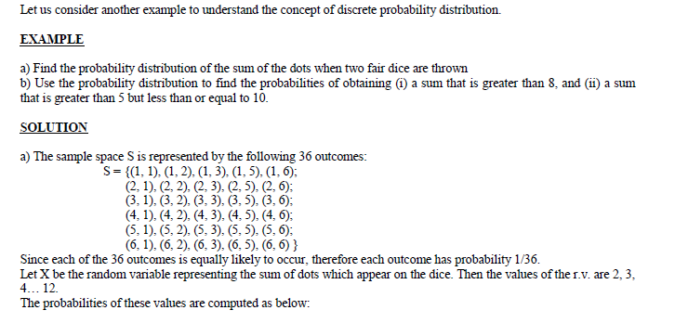

Slide 7
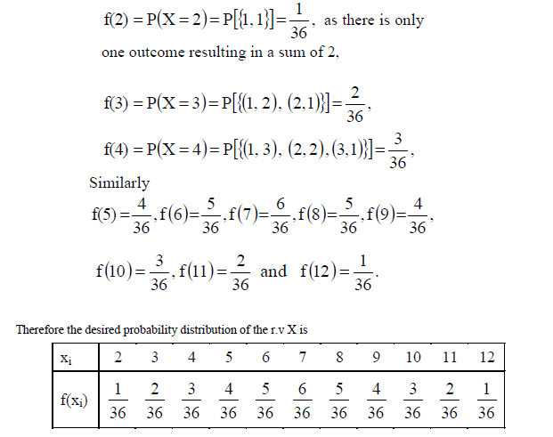

Slide 8
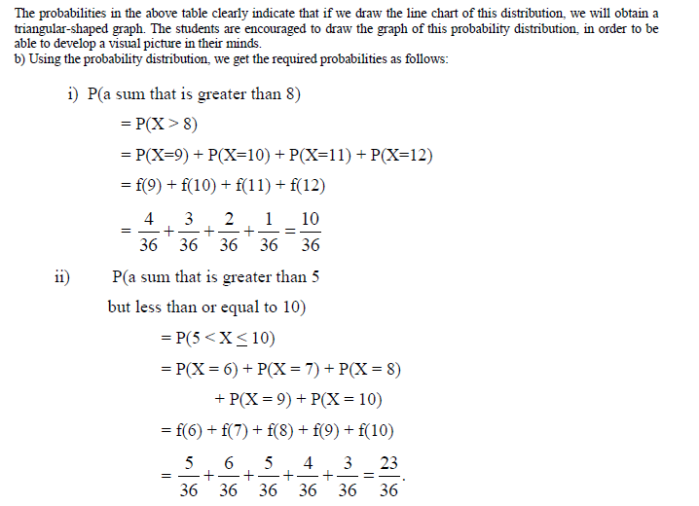

Slide 9
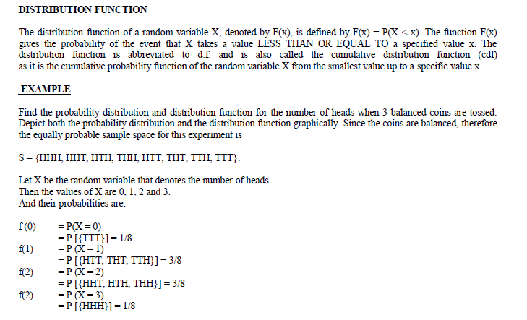

Slide 10
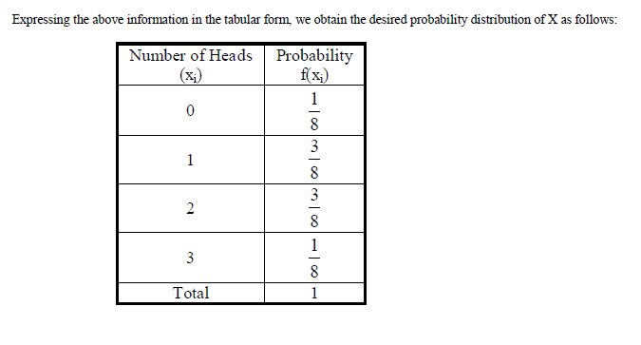

Slide 11
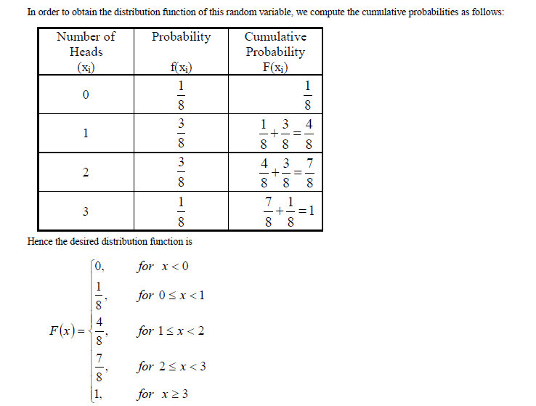

Slide 12
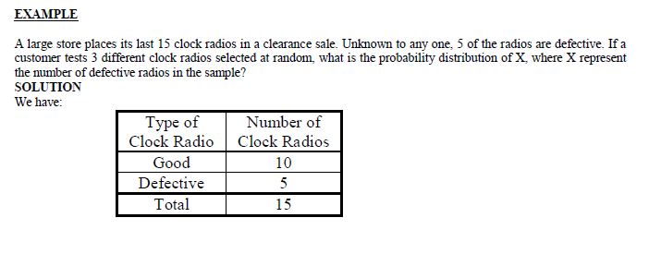

Slide 13
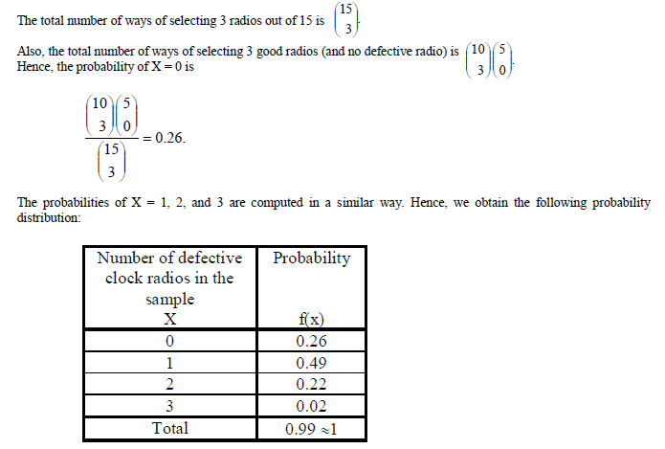

Slide 14
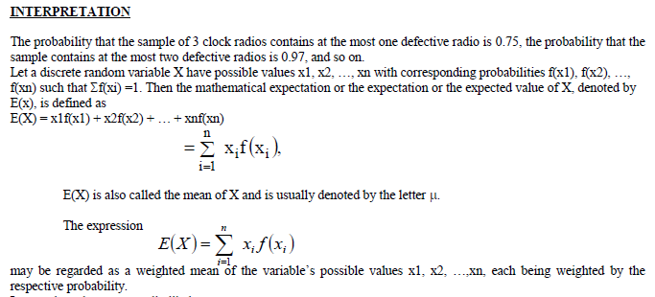

Slide 15
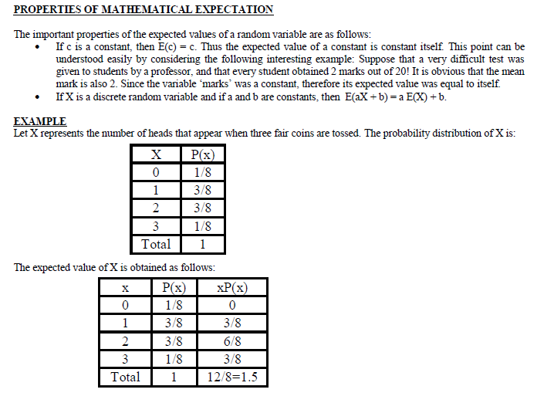

Slide 16
